Slide 1
Guide to a good Technical Resume
PSU ACM
Fall 2013
Notes:
The Engineering Career Fair is coming up and all of you should go. Even freshmen get hired and it’s better to start early regardless. The more you talk to companies the better you’ll get at it. So hone your skills if nothing else. Since hopefully you’re all now going you’re going to need a resume. Let’s talk about how your resume gets used.

Slide 2
Life Cycle of a technical resume
The Initial Screen.
The Interview Decision.
The Interview Itself.
Notes:
So here I’ve identified the three main stages your resume goes through. The first is an initial screen. Someone, normally at the career fair itself will scan your resume looking for specific things like class standing or GPA, then sort you into a pile. Either a definite no, a maybe, a definite yes or something similar. After that they’ll look more closely at your resume and decide whether or not to invite you back for an interview. At this stage you’re normally being compared to the other resumes they’ve received, if yours stands out you’ll get a callback. Finally there’s your interview itself. Here you resume is what you hold up to an employer to verify you’re qualified to hold the job.

Slide 3
Things Companies Screen For
Class Standing
GPA
Specific Classes Taken
Prior Work Experience
Specific Technologies
Notes:
So here are some things employers check to make sure you meet the job requirements. Class Standing, for instance some companies only hire juniors for internships. Others are only hiring full time positions so they only want seniors. Some have specific programs for freshmen and sophomores. Some companies, particularly government contractors and consulting companies, have GPA constraints, normally a 3.00 or higher. Some companies look to make sure you’ve taken specific classes. IBM for instance wants it’s co-ops to have completed 311, Google wants you to have done 122. Just FYI about the 122 they’re going to ask you if you’ve completed “data structures and algorithms” they are talking about 122 not 465. Some companies want you to have prior work experience, Microsoft is a good example here. Some look for specifics technologies or programming languages, Google generally requires Java for instance.

Slide 4
Things that will help you get an Interview
Personal Projects
Prior Work Experience
Demonstrable Accomplishments
Clear Passion for Comp Sci
Networking / Community Participation
Diverse Interests
Notes:
Remember if you make it past the initial screen you still have to compete with everyone else who wants the job. You can assume everyone has taken roughly the same classes you have. So what will set you apart? Work you’ve done beyond the classroom. Either through personal side projects or previous internships. Beyond that things like attending hackathons and competitive programming competitions show you’re passionate about what you do. Contributing to open source software (you have a git hub account don’t you?), the clubs you participate it and organizations you are a part of that includes non-computer science related things as well. If you have a scuba license or love rock climbing or are a member of the boxing team, there’s a place on your resume for that too.

Slide 5
Things that will help you in your Interview
Substance that backs up your resume
Genuine accomplishments, not just responsibilities
Great talking points
Notes:
Finally once you get into your interview remember that you need to back up any claims you made, be prepared to explain in detail how you implemented any of your projects, what technologies you used, etc. Be prepared to talk specially about your role in group projects, so if you were responsible to a group of 4 people make sure you can explain what you did as the group leader. Great talking points are things on your resume that interviewers can use to start conversations.

Slide 6
Things to Avoid
Bad English
Filler Information
Exaggeration (or lying)
Weasel Words
Buzz Words
Lists
Too Much Detail
Including Personal Information (race, religion, gender, birthdate, photo)
Notes:
We’ll run down this list real quick: spelling and grammar mistakes are very preventable and will cost you jobs. Seriously run your stuff through spell check and by a buddy. Filler information, if you have things on your resume that just take up space I’ll assume you didn’t have anything else to put there. Exaggeration, don’t make it seem like you’ve done more than you really have, normally recruiters can spot this and even if they don’t you’re setting yourself up for failure during the interview itself. Weasel words, so these are things like “participated”. Other examples are “proposed”, “learned”, “studied”, etc. You resume should also not be a collection of buzz words, that will be painful for everyone involved. Going into too much detail can be tricky but if you’re including the specifics of how you implemented something you’ve probably gone more in depth than the resume merits. Finally personal information, this seems obvious but it really isn’t, companies are legally not allowed to discriminate either for or against you so there’s nothing to be gained by offering your personal information, but there’s potentially a lot to lose.

Slide 7
Putting it together
Notes:
Okay so now we understand the purpose of resumes, and generally what we should or should not highlight, let’s get specific.

Slide 8
Academic Information:
Your GPA – Consider including in-major GPA.
Your expected graduation date.
Your major.
Classes you’ve taken*
Consider putting this information either at the very top or very bottom.
* There is a right and a wrong way to do this.
Notes:
Not much to say here, you need to put your academic info. Likely your in-major GPA is higher than your overall so include that. I’ve said here consider putting this information either at the very top of very bottom, this is mostly used for screening purposes so getting it out of the way early makes sense, as does getting it out of the way of your real experience.

Slide 9
A very Wrong way to include classes:
Relevant Courses:
Computer Programming
Digital Systems
Multivariable Calculus
Matrices and Statistics
Mechanics
Electricity & Magnetism
Notes:
Congratulations you’ve described a skill set possessed by everyone in at least three college majors.

Slide 10
A Wrong way to include classes:
Relevant Coursework
CMPSC111S: Logic for Computer Science
CMPSC121: Introduction to Programming
An introductory programming class, learned the basics of C++
CMPSC122: C++ with Data Structures
Continuation of C++
Learned about several data types
CMPSC221: Object Oriented Programming with Web Apps.
Learned Object Oriented Programming, learned Java
Several team projects (Teams of 2-4)
CMPSC311: Introduction to Systems Programming
Concentrating on the C programming language
Concentrating on the Unix and Linux operating system
Learn about systems programming
Notes:
All you’ve done here is replicate the penn state syllabus. This would be true for every single person they talk to that day.

Slide 11
The Right way to include Classes:
Relevant Coursework
CMPSC 121: Wrote a black jack simulation.
C++ command line application.
Maintained and improved the applications over the course of a year.
Now includes 27 different casino games.
CMPSC 122: Created a store locator application
Used a Java Swing Application as the frontend.
Read from a Derby database.
CMPSC 221: Created an Angry Birds Clone
Java Applet
Worked on a team of four people
CMPSC 458: Simulated a rollercoaster ride
Done Using OpenGL
Implemented dynamics lighting conditions
IST 567: Design for Data Mining Applications
Notes:
So you can see here what you want to do is focus on what you’ve built. You can still talk about what the course was about but frame it in terms of a project you completed. Obviously the exception is if you’ve taken a really interesting course like the one at the bottom and didn’t do any projects for it. Then go ahead and put that on your resume.

Slide 12
The wrong way to include skills:
Programming Experience:
C
C++
Java
SQL
HTML
Assembly Language
Mac OS
Linux
Notes:
While this is better than nothing you might as well just be naming technologies you’ve heard of.

Slide 13
The Right way to include Skills:
2013: At the PennApps 2013 created a robot that mixes drinkes using an ardunio controller and C++.
2012: Created an application using CURL via PHP to automatically trade stocks on Ka-Ching (now Wealthfront).
2012: Wrote a User Interface in Java for a biology professor’s DNA sorting/matching research.
2011: Rewrote a local dating service’s matching code (Turbo PASCAL and CSV files) in C# using a mySQL database.
Notes:
So you can see here what you want to do is focus on what you’ve built. You can still talk about what the course was about but frame it in terms of a project you completed. Obviously the exception is if you’ve taken a really interesting course like the one at the bottom and didn’t do any projects for it. Then go ahead and put that on your resume.

Slide 14
You (probably) don’t need an objective
Objectives are used to show intent beyond your resume.
You Objective probably looks like this:
“Objective: To obtain a job in the software industry working as a developer.”
So does everyone else’s. That part is understood.
Exception: When there’s a specific job you want or company you want to impress:
“Objective: To obtain a job as a security analyst at the NSA’s Boston location.”

Slide 15
“Objective: To Work for Samsung” - Top of a Resume sent to apple

Slide 16
Include your previous work experience:
Focus on what you accomplished during the job, not just it’s description.
Be wary of putting too much information about non-tech jobs for example:
Work:
Burger King - Cashier March 2009 – June 2009
Process hundreds of customer transactions and manage thousands of dollars per day.
Help fellow associates by describing what tasks to perform and how goals should be met, assemble & fulfill orders and assist customers with new store technologies.
Manage, clean and maintain facilities, storefront, equipment, computers and registers.
Trained others in proper technique and procedure.

Slide 17
It’s okay to put on High School Achievements
As you gain experience you can replace them.

Slide 18
Fill the rest of your resume with:
Extra Curricular Activities (including ACM).
Any scholarships or awards you’ve won.
Interesting hobbies or sports.
Links to your:
Github Page
Stack Overflow Profile
Blog
Personal Website
Project Portfolio
Links to things you’ve made
X There’s no need to say, “References Provided upon Request”

Slide 19
Stick with a 1 page maximum

Slide 20
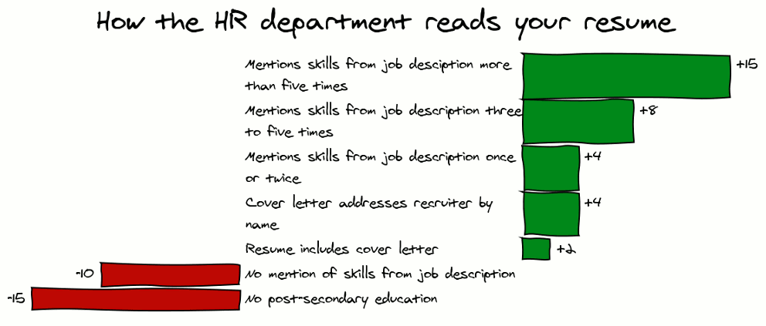

Slide 21
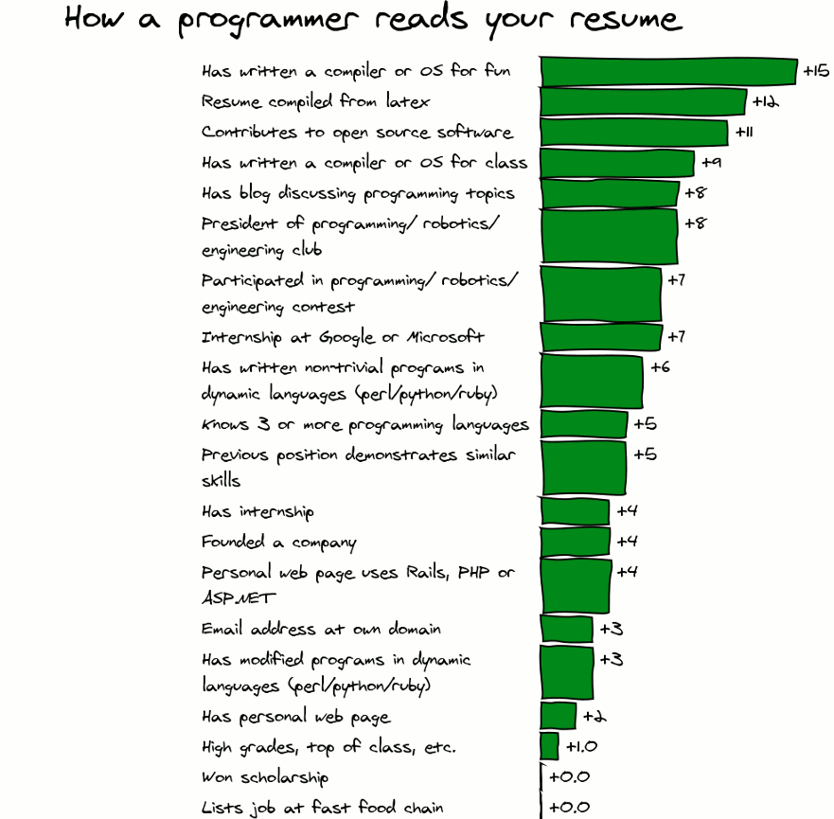

Slide 22
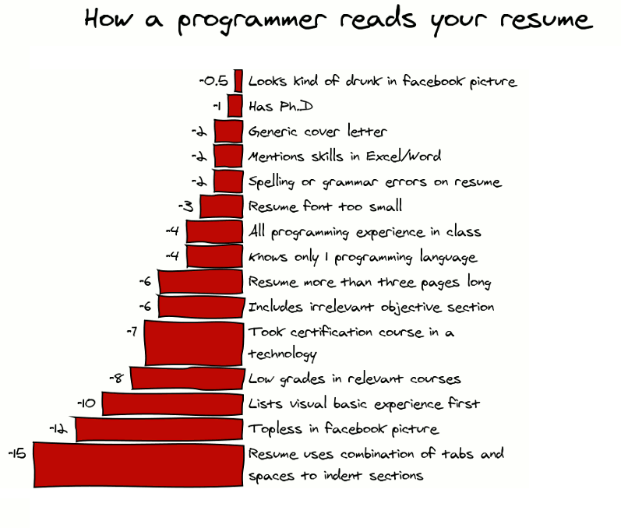

Slide 23
Final Thoughts
Don’t go to the career center for resume help (seriously).
Get to know your professors
Start early
Revise often
Have someone else look over your work

